Slide 1
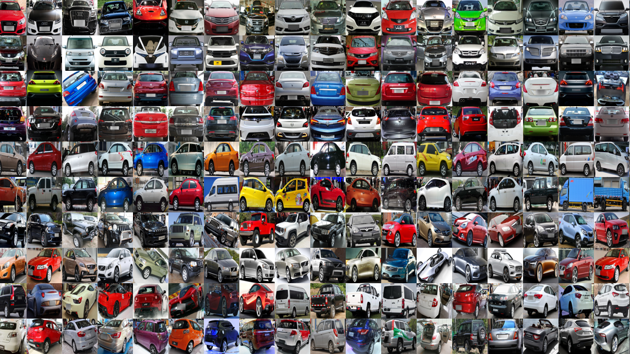
Bosch Assessment Data Scientist
Ana Nunes

Slide 2
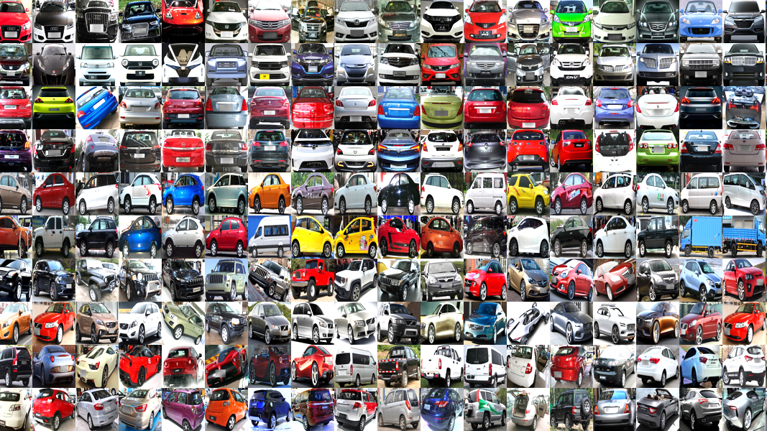
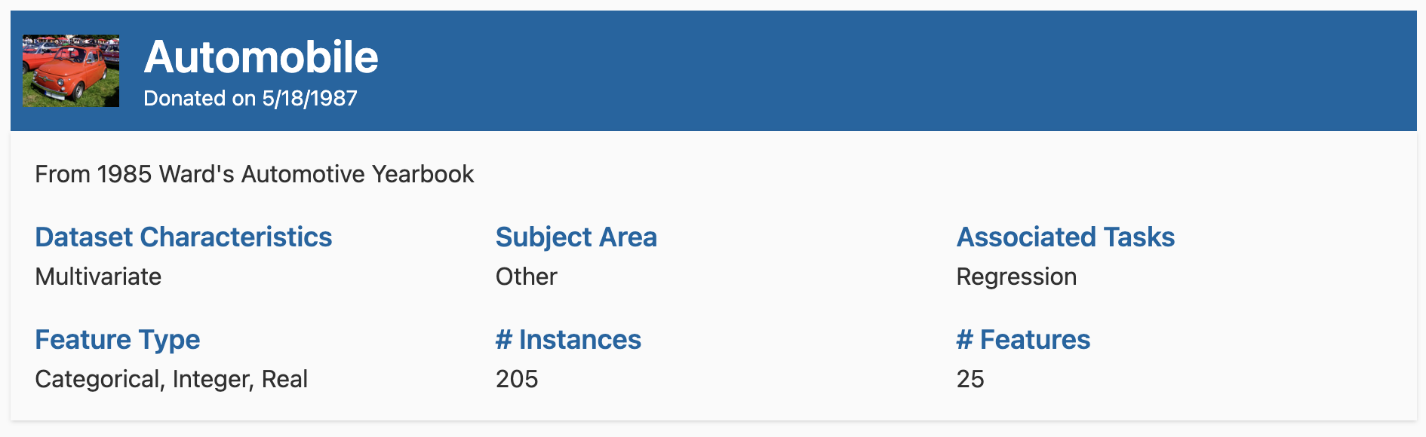
Overview
The objective was to perform a thorough analysis of the automobile dataset and build a machine learning model to predict a target variable (price).

Slide 3
Summary
Exploratory Data Analysis (EDA)
Missing Values
Data Distribution
Categorical Variables Encoding
Outlier Removal
Correlations
Feature Engineering and Selection
Machine Learning Model
Evaluation and Interpretation
Conclusions

Slide 4
Exploratory Data Analysis (EDA)

Slide 5
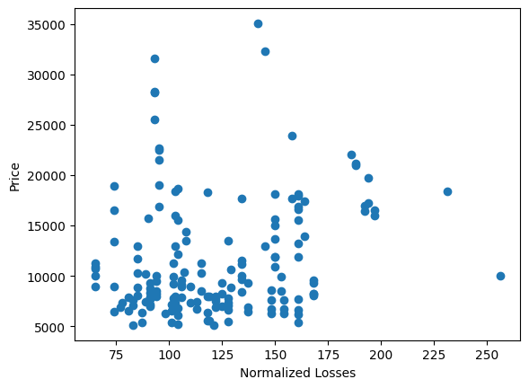
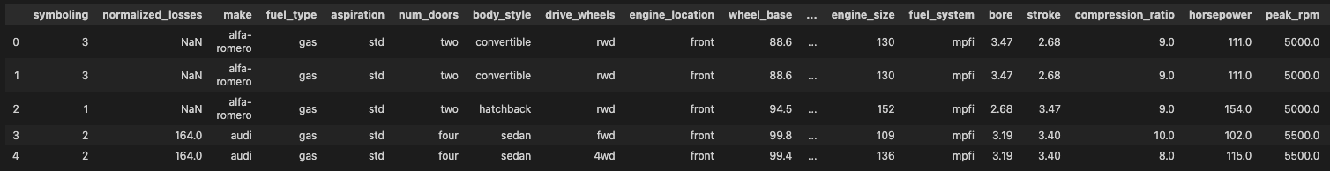
Missing Values
Removed normalized losses (41 missing values);
Removed rows with missing price (4 rows);
Used the column mean for the remaining missing values (14 entries).
Notes:
41 missing values for normaliz losses

Slide 6
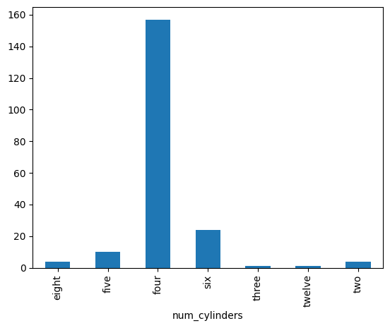
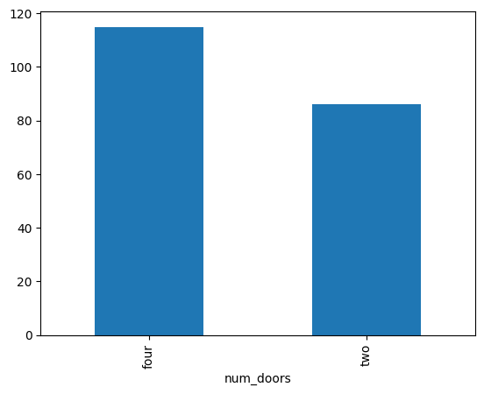
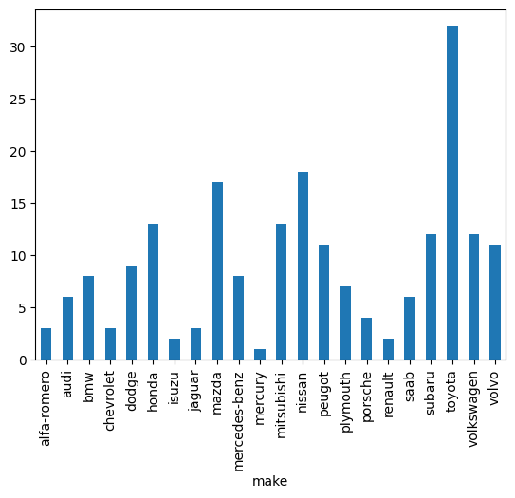
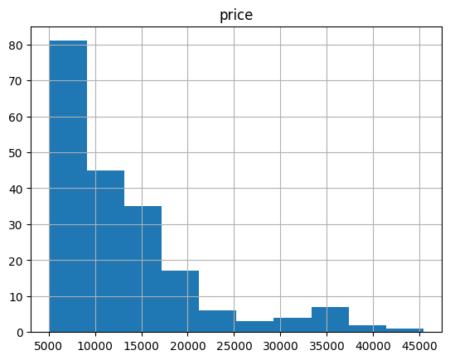
Data Distribution
Unbalanced categorical;
Categorical variables convertible to numerical;
Price follows a power law distribution;

Slide 7
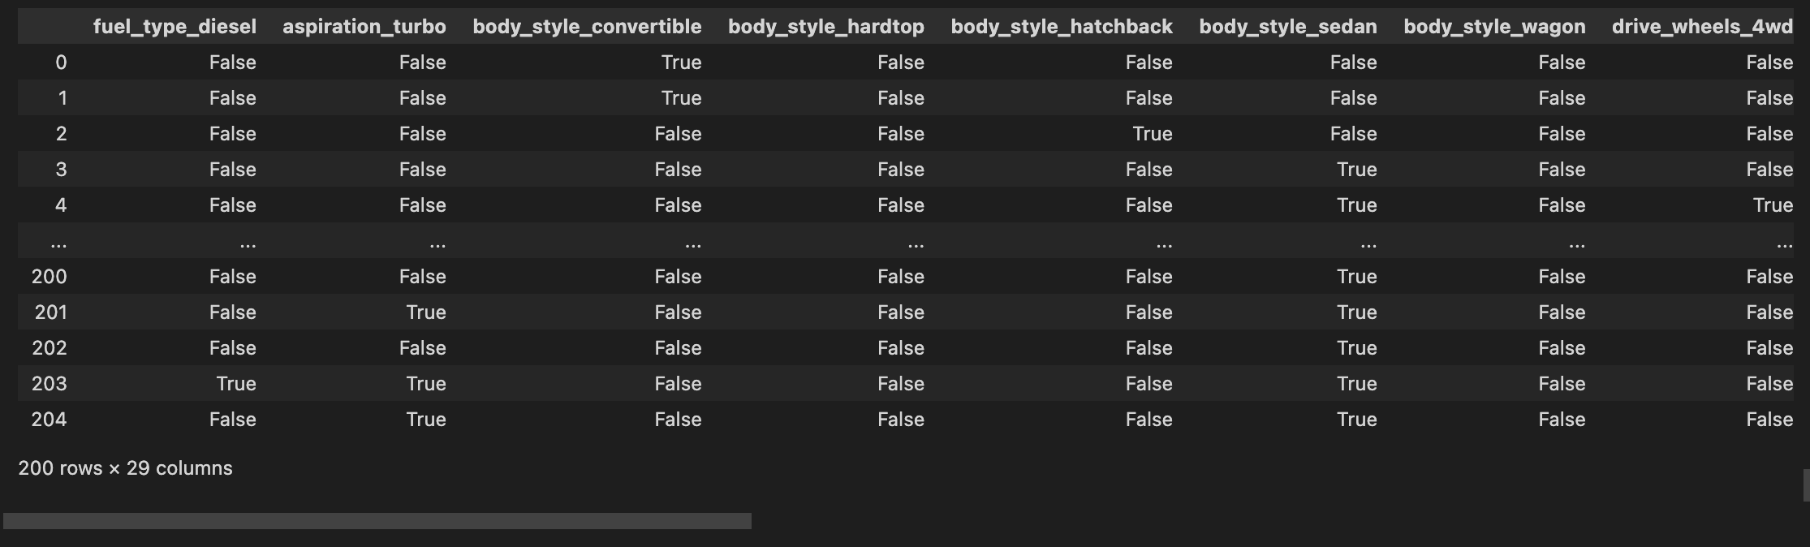
Categorical Variables Encoding
Replacement of string representation to numerical representation (number of doors and cylinders);
One-hot encoding for remaining;

Slide 8
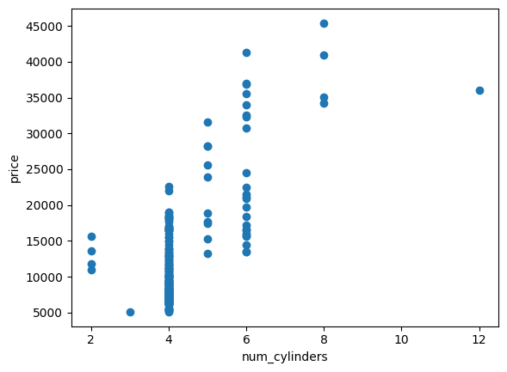
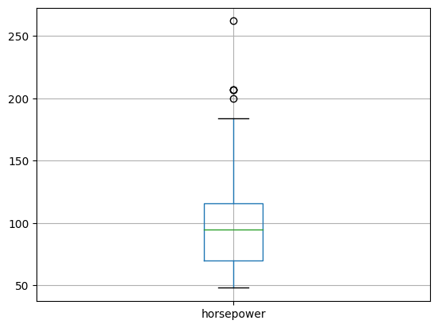
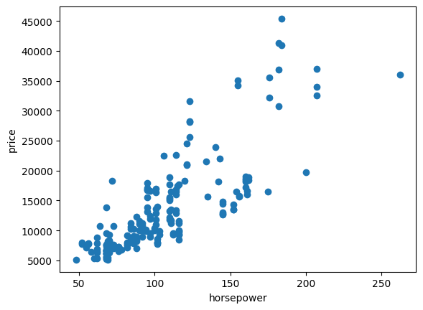
Outlier Removal
Only one value was considered an outlier (number of cylinders > 12);
Some of the outliers detected in the box plot seem to follow a pattern;

Slide 9
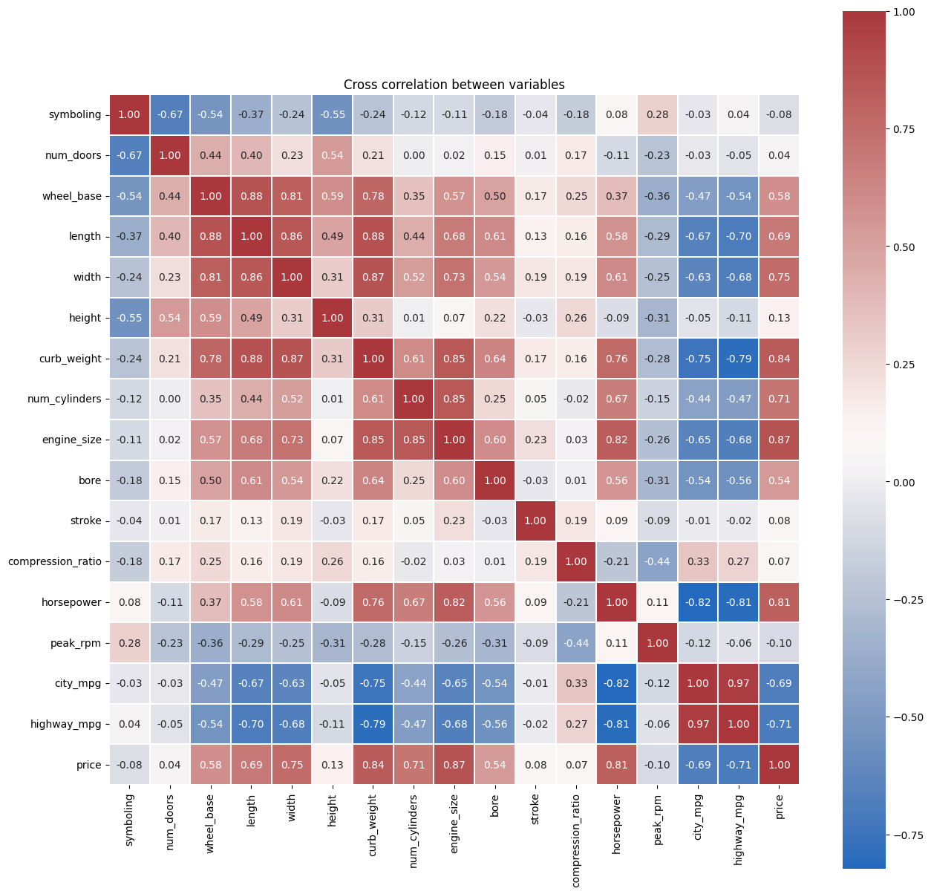
Correlations
Some features not correlated with the price;
Correlations between independent variables (multicollinearity);

Slide 10
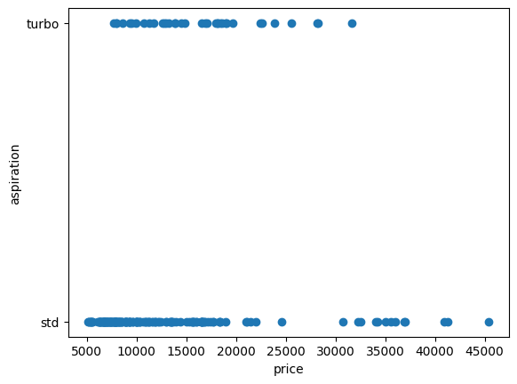
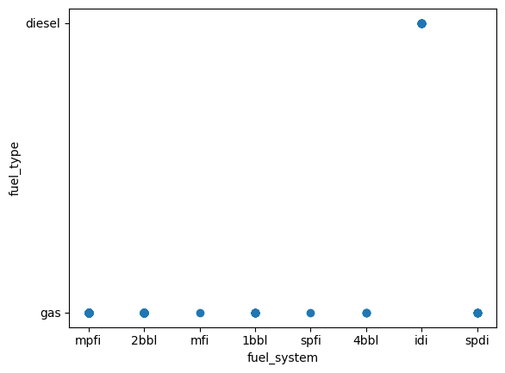
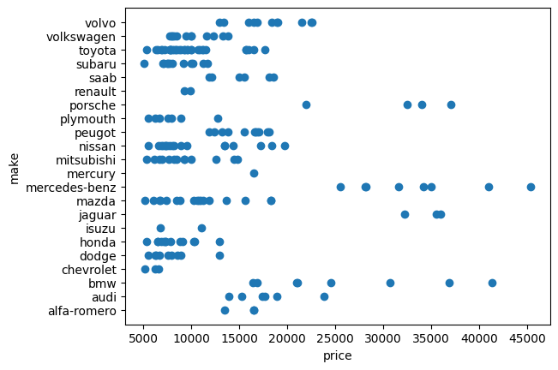
Correlations
One hot encoded variables with two classes, one can be removed;
Combined ‘make’ by price range;

Slide 11
Feature Engineering and Selection

Slide 12
Feature Selection
Based on the EDA, the following features were removed:
Numerical: 'symboling', 'num_doors', 'compression_ratio', 'peak_rpm’.
Categorical: 'fuel_type_gas’,'aspiration_std', 'engine_location_front’.
On a later stage a model will be tested with only visual selected features, namely, by analysis of the scatter points of relationship with the price, the following features were selected: 'length', 'width', 'curb_weight', 'num_cylinders', 'engine_size', 'horsepower', 'city_mpg', 'highway_mpg’.
Notes:
(low correlation with the price).
One hot encoding and idi

Slide 13
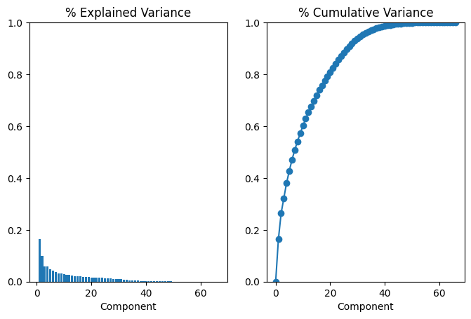
Feature Engineering
Numerical
Engine Power = Engine Size * Horsepower;
MPG = (City MPG + Highway MPG) / 2;
Categorical
Group ‘make’ by price range;
Principal Component Analysis (PCA)
Selection of 40 components;
Notes:
(low correlation with the price).
One hot encoding and idi

Slide 14
Features
Final feature selection:
Numerical: 'wheel_base', 'length', 'width', 'height', 'curb_weight', 'num_cylinders', 'bore', 'stroke', 'engine_power', 'mpg’;
Categorical: 'fuel_type', 'aspiration', 'body_style’, 'drive_wheels', 'engine_location', 'engine_type', 'fuel_system', 'make_luxury', 'make_slightly_expensive', 'make_expensive', 'make_less_expensive’;
Notes:
(low correlation with the price).
One hot encoding and idi

Slide 15
Machine Learning Model

Slide 16
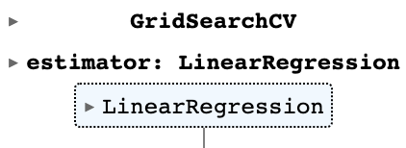
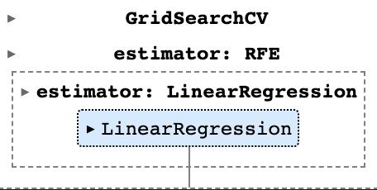
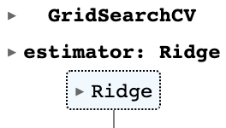
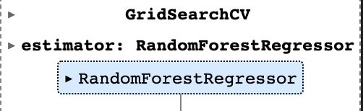
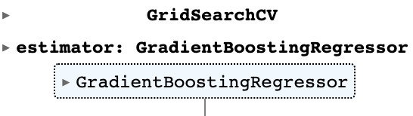
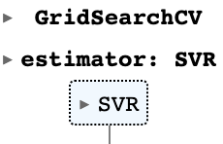
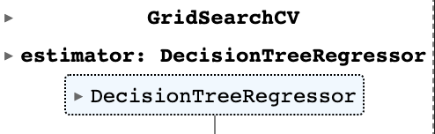
Model Selection
Starting with a Linear Regression model due to its simplicity and gradually progress to more complex models;
Retrain and assess the results for the model after each decision that was taken in the previous sections, starting with a model with all the features (benchmark);
Use of a grid search with cross validation to tune any hyperparameter.

Slide 17
Hyperparameter tuning
fit_intercept
n_features_to_select
solver
n_estimators
criterion
kernel
loss

Slide 18
Evaluation and Interpretation

Slide 19
Results
Model | Optimal Hyperparameters | Train Set Error | Validation Set Error | Tes Set Error | r²
Benchmark | {'fit_intercept': True} | 1.757e-22 | 1.440e+02 | 955.31 | 0.99
+Without outliers | {'fit_intercept': True} | 2.552e-22 | 2.769e+02 | 724.34 | 0.99
+Numerical feature selection | {'fit_intercept': True} | 6.087e-22 | 5.321e-22 | 720.20 | 0.99
+Categorical feature selection | {'fit_intercept': True} | 2.656e-22 | 2.654e-22 | 720.20 | 0.99
PCA | {'fit_intercept': True} | 2.080e-23 | 1.948e-23 | 1255.56 | 0.98
Visual Selection | {'fit_intercept': True} | 2.627e-22 | 3.123e-22 | 720.20 | 0.99
RFE | {'n_features_to_select': 2} | 2.035e-24 | 1.300e-24 | 956.58 | 0.99
Ridge Model | {'solver': 'lsqr'} | 69905.775 | 234146.008 | 868.46 | 0.99
Random Forest | {'n_estimators’: 47} | 170593.812 | 942381.917 | 1229.47 | 0.98
Decision Tree | {'criterion': 'poisson'} | 0 | 2069561.357 | 1122.47 | 0.98
SVR | {'kernel': 'linear'} | 53382624.904 | 54049912.779 | 7944.61 | 0.11
Gradient Boosting | {'loss': 'huber'} | 9.089e+03 | 949950.453 | 895.22 | 0.99

Slide 20
Conclusions & Challenges
Notes:
The model that presented the best results was the LinearRegression with outlier removal and feature selection/engineering reaching a RMSE for the test set of 720, meaning that on average the prediction has an error of 720 euros. The obtained explained variance was 0.99 (1 means a perfect fit), which measures the proportion of the variance in the target variable that is explained by the model.
Tabular data, been working with images

